Slide 1
Progress

Slide 2
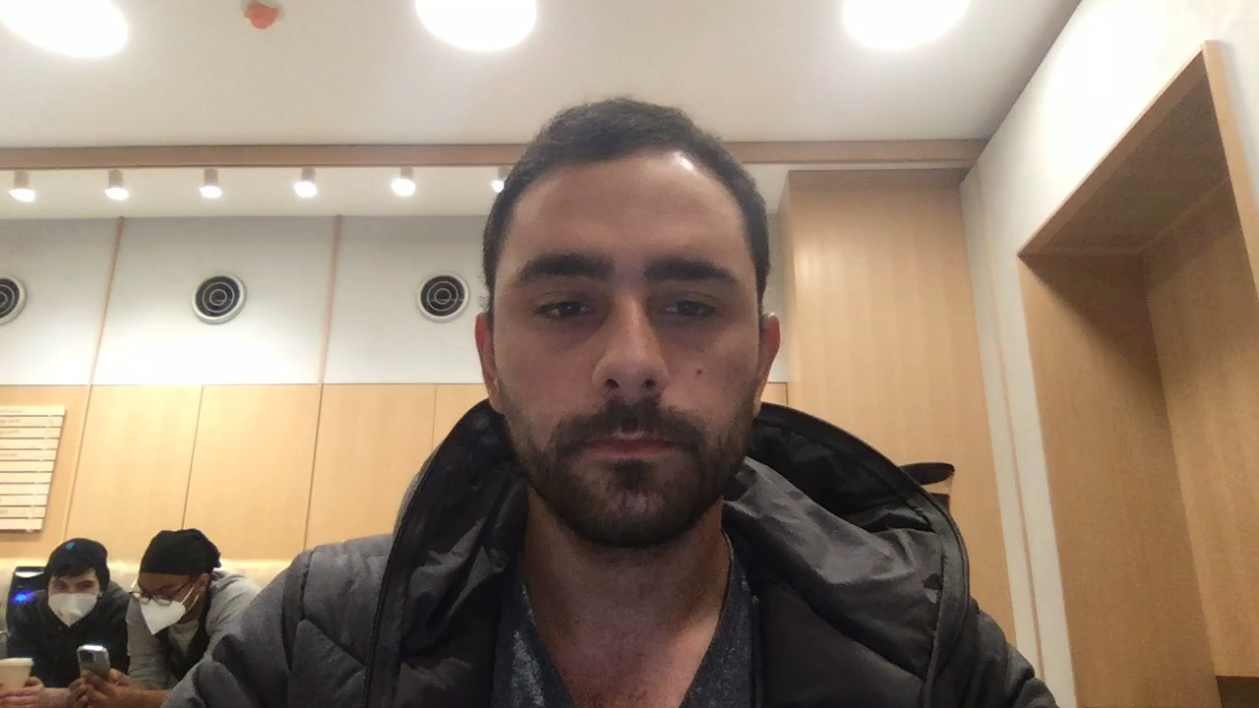
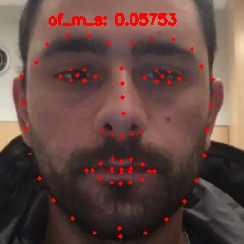
Pre-processing
Raw
Processed

Slide 3
Pre-processing
Main Processing steps:
Detect the face
Detect facial landmarks (68)
Crop the face
Face alignment: correct head pose such that the face is as frontal as possible. Currently only correcting for head roll.
Frame resize: make sure all frames are the same size.
Raw
Processed

Slide 4
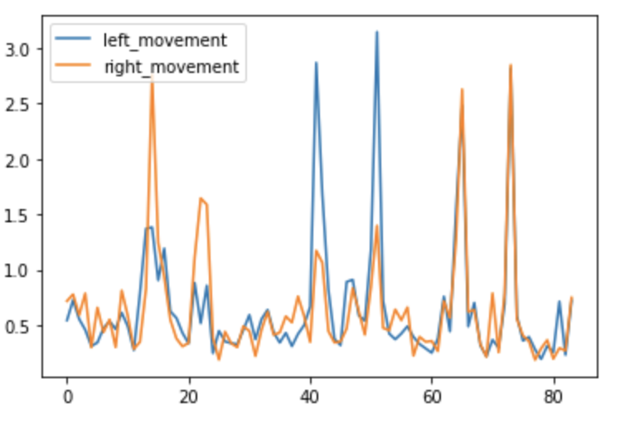
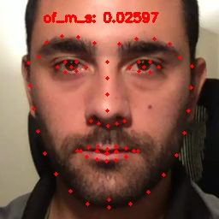
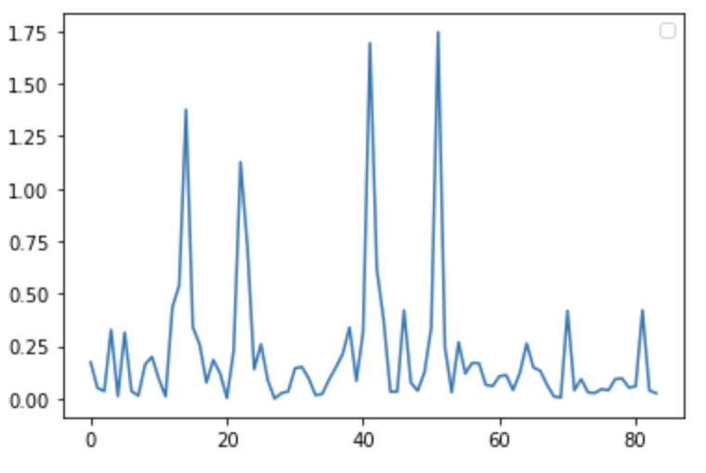
Mouth Optical Flow Symmetry
Mouth movement
Amount of movement
Mouth symmetry

Slide 5
Questions
Can we tell if a person is having a stroke from the facial test alone?
The patient does four tasks: smile, brow raise, eye closure, tongue protrusion. How many of this tasks should show asymmetry in order to diagnose as a stroke? One? All?

Slide 6
Questions
For any of these tasks, do we care about the movement of the face while making the expression? Or just the final state of the expression?
For example, in facial expression recognition we can do a decent job just with the final estate of the face.

